Slide 1

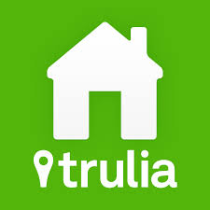
Scrapping Trulia
Samriddhi Shakya

Slide 2
About Trulia
online residential real estate site for home buyers, sellers, renters and real estate professionals
It lists properties for sale and rent as well as tools and information needed to be successful in the home search process.
On July 28, 2014, Zillow announced a deal to buy Trulia for $3.5 billion.^{[3]}

Slide 3
Some Facts about NYC Rents
1) Most NYC renters live in apartments that are subsidized in some way: 8.2 percent live in public housing, 8.4 percent in subsidized housing, and 45.4 percent in units that are under rent stabilization or rent control.
2) Median monthly rents increased from $999 in 2007 to $1,084 in 2011, a difference of 8.5 percent.
3) Median gross rent (the base rent plus estimated utilities) rose 10 percent between 2005 and 2011, but median household income in New York City fell.
4) A severe rent burden is spending more than 50 percent of one's household income on rent, and 31 percent of New Yorkers were severely rent burdened as of 2011 (compared to 27 percent in 2007).

Slide 4
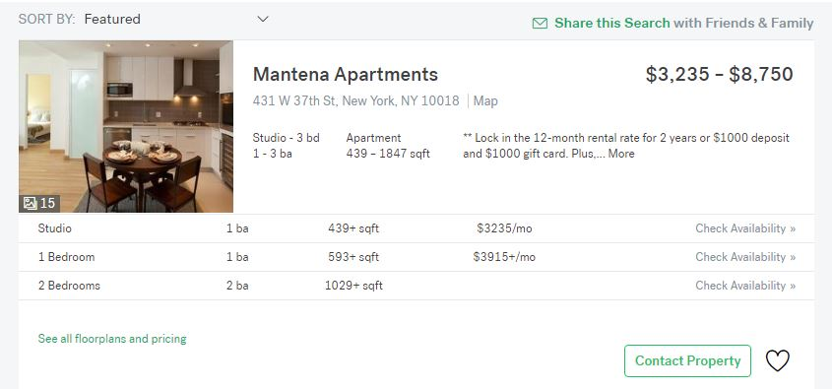
Scrapping Project

Slide 5
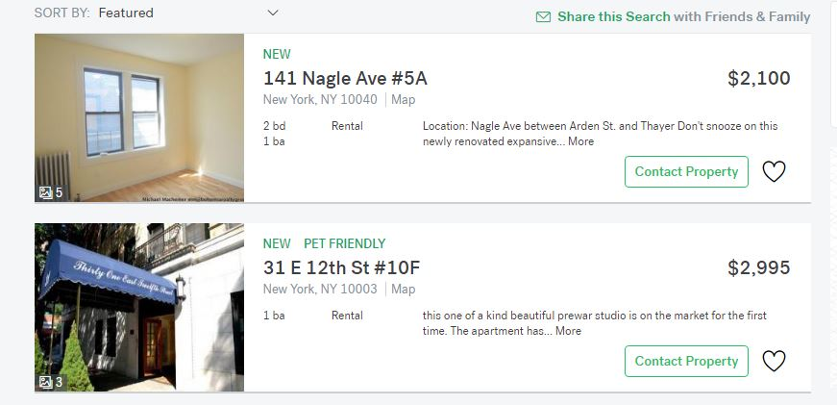

Slide 6
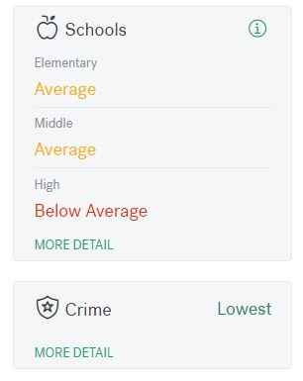
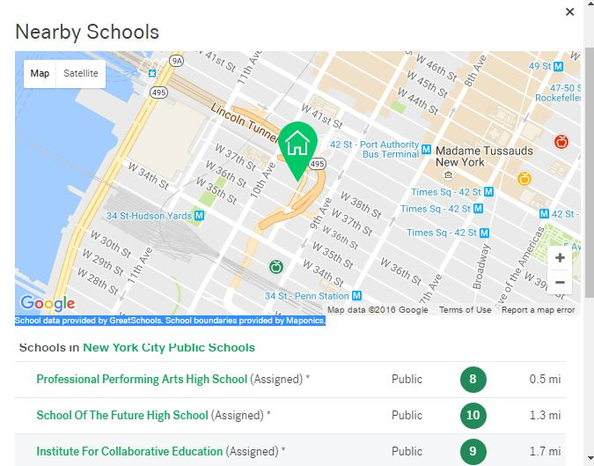
School Ratings

Slide 7
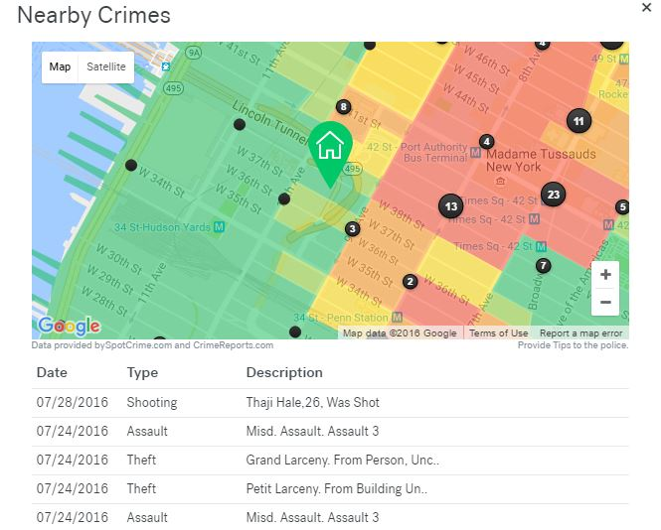
Crime Info

Slide 8
Data - 2 Parts
1. Apartment Community Complex - Total = 86
Studio Apartments
1 bed room Apartments
2 bedroom Apartments
2. Individual Apartments/Condo/ Townhomes – Total = 6767
1-7 bedroom

Slide 9
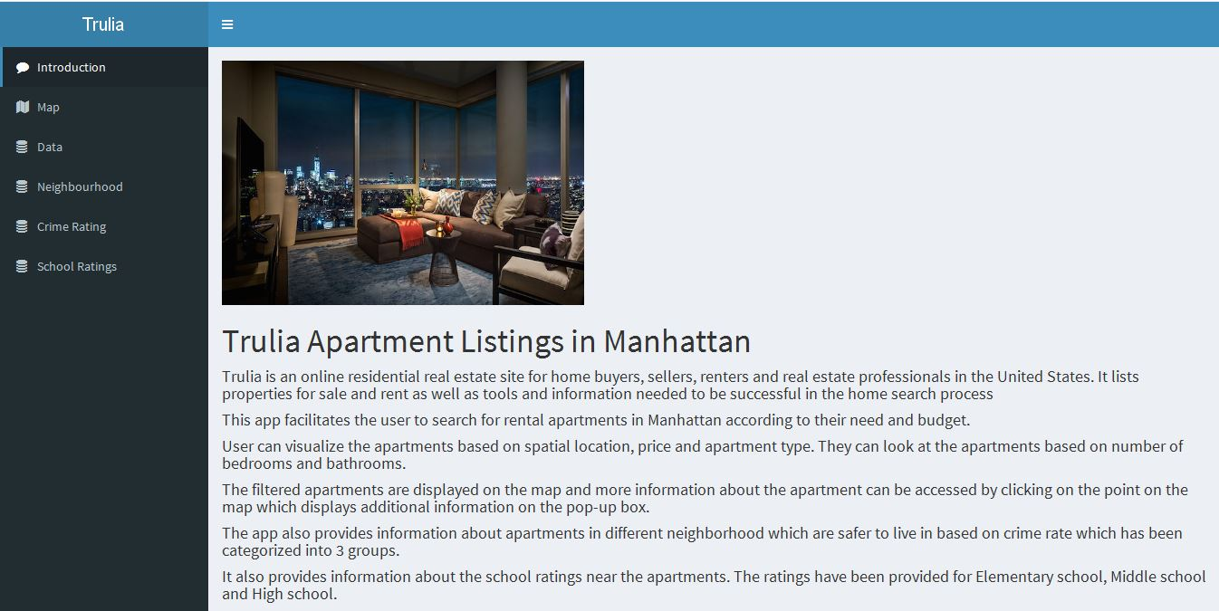

Slide 10
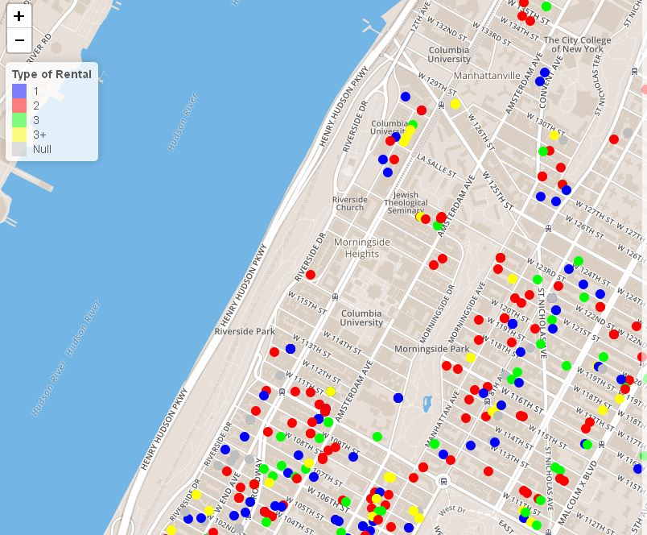

Slide 11
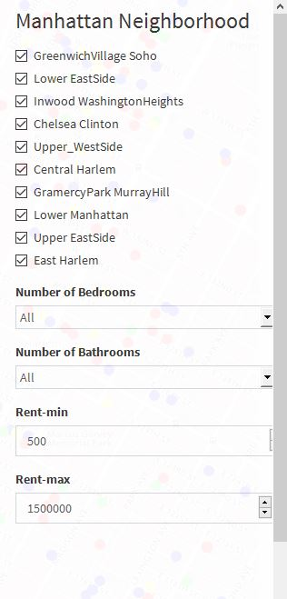
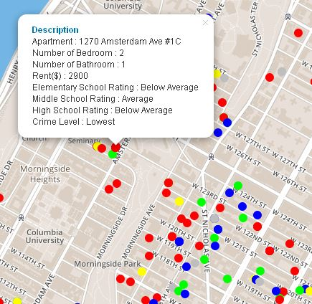

Slide 12
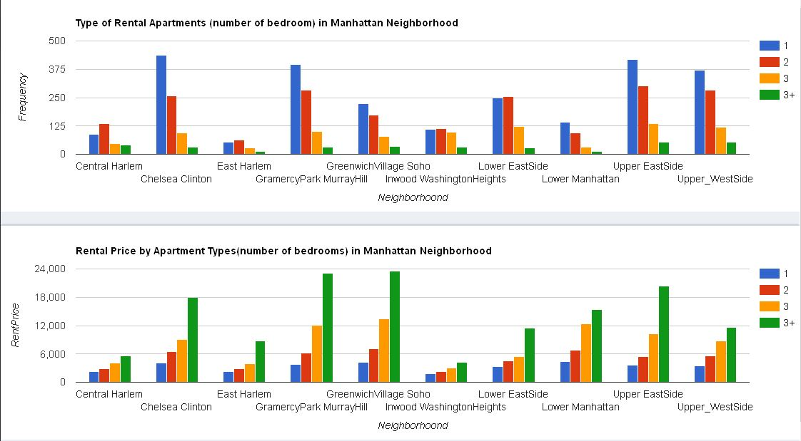

Slide 13
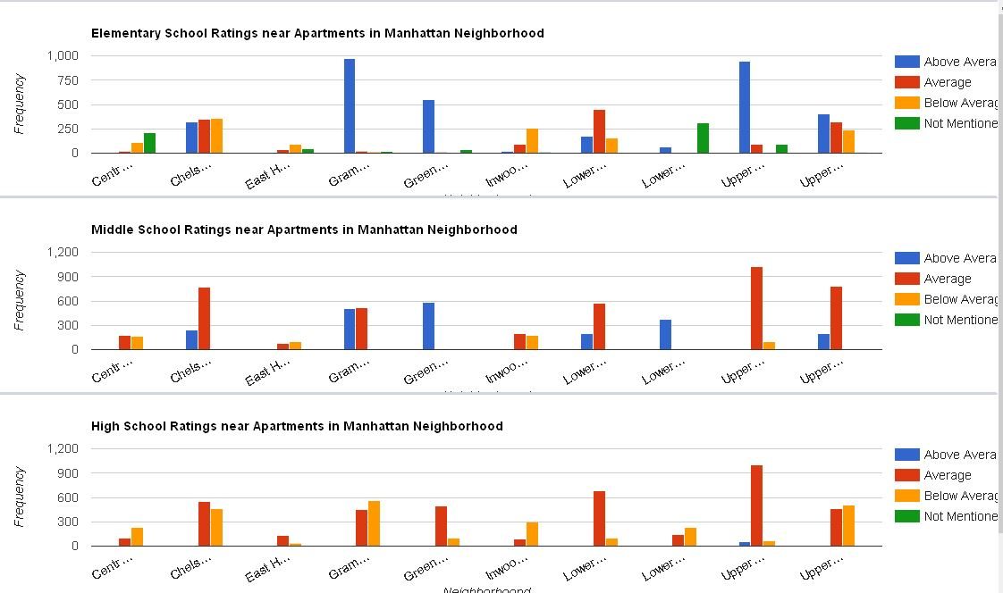

Slide 14
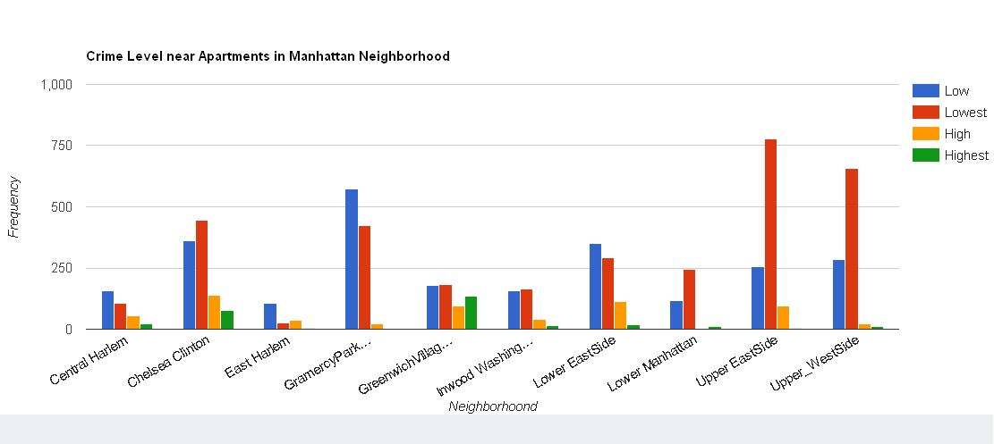

Slide 15
App Demonstration

Slide 16
Future Works
Expanding to other boroughs on New York
Include more data from the website
Add more Features to the map
Add Pictures of the Apartments
Built a regression model to estimate price based on different predictor data.

